Slide 1

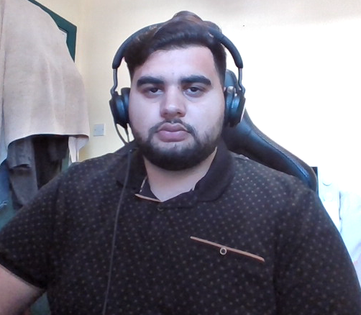
AZ BOOKINGS
Ashar Zafri
Year 4 Project Engineering 2021/2022
Bachelor of Engineering (Honours) in Software and Electronic Engineering
Galway-Mayo Institute of Technology

Slide 2




Is my barber available today?
How many people are head of me?
Why do I have to wait so long?

Slide 3
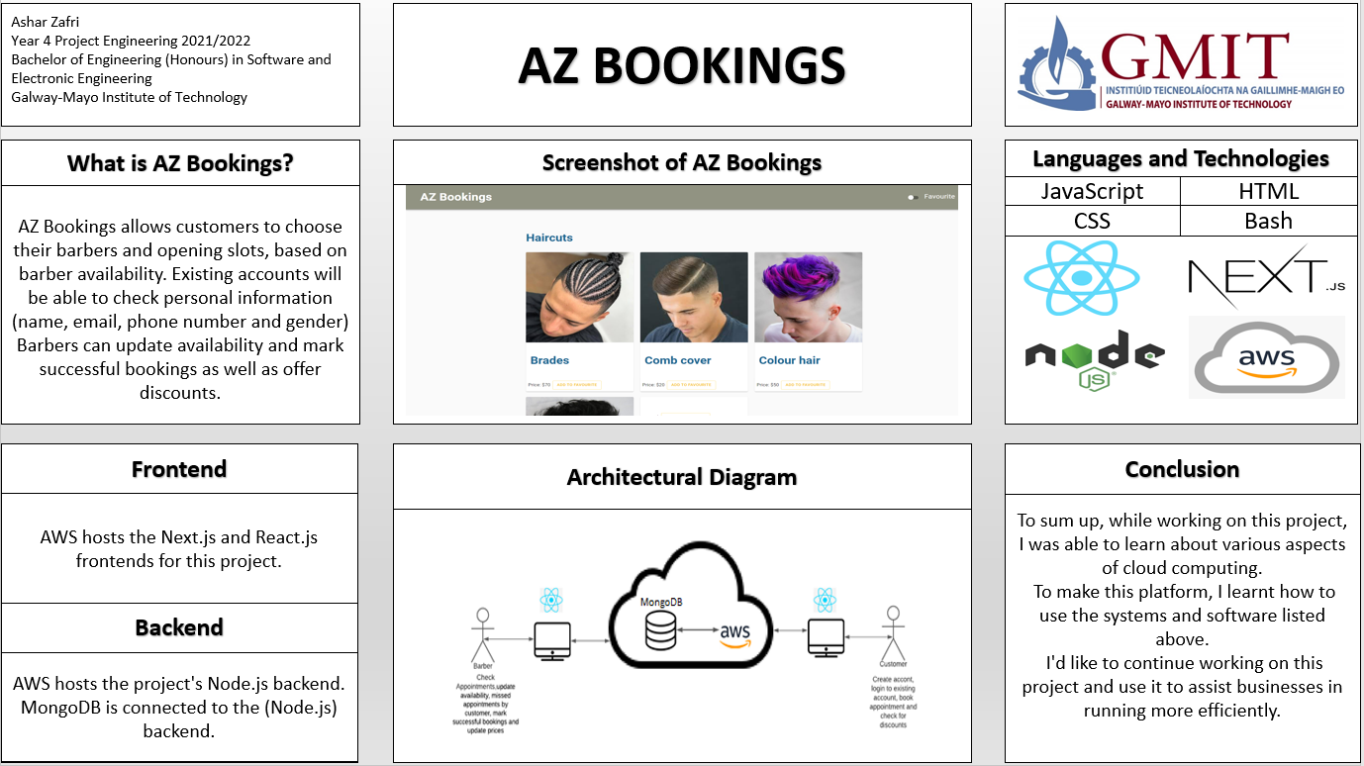

Slide 4
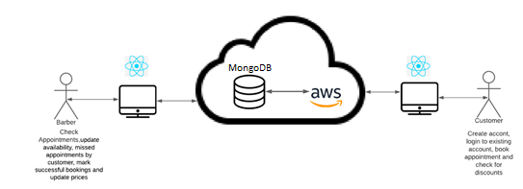

Slide 5
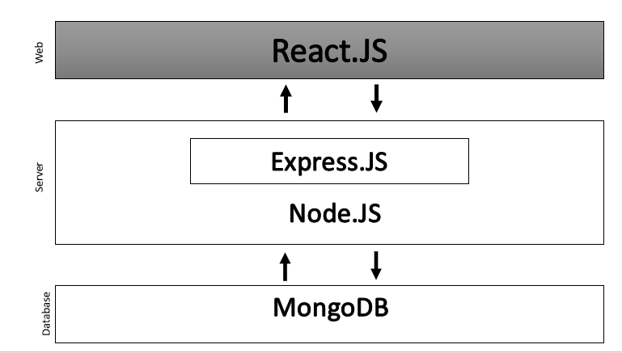

Slide 6




Languages and Technologies
JavaScript
HTML
CSS
Bash

Slide 7
Project Demonstration

Slide 8
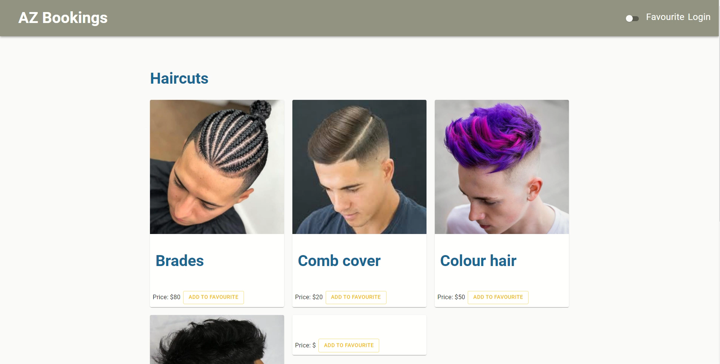

Slide 9
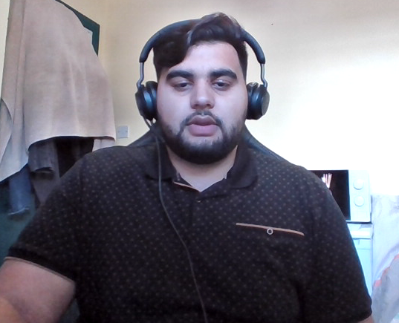
Thank you for listening

Slide 10
References:
https://icon-library.com/png/965850.html question icon
https://www.istockphoto.com/photos/question-emoji question icon
https://www.dreamstime.com/illustration/guess-icon.html question icon

